Slide 1
Problem Statement ID : PS-6
HACK KRMU 5.0
Team Name : Codex
Team Id : HK- 026
Team Members : Dolare Shruti Manohar
Jatin Rajour
  Boby Deshwal
  Shourya Awasthi
01

Slide 2


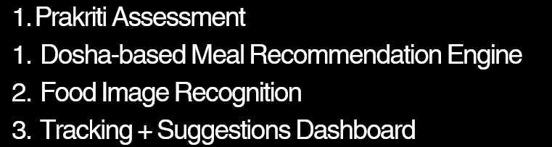
HACK KRMU 5.0
Problem & Solution
PROBLEM
STATEMEN T :
Develop a mobile application that analyzes Prakriti assessment and generates personalized
  Ayurvedic meal plans with image-based food tracking
  OUR SOLUTION :
02

Slide 3
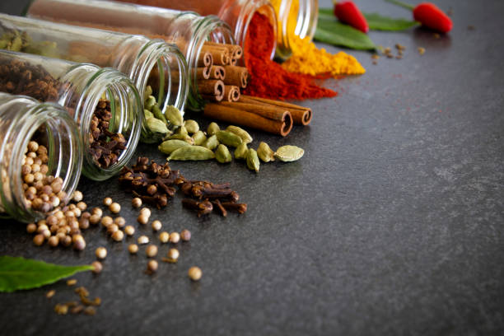
HACK KRMU 5.0
Flow of
Solution :
Content (Use arrows visually in PPT):
User Registration
↓
Prakriti Assessment Quiz
↓
Dosha Classification (Vata / Pitta / Kapha)
↓
Personalized Meal Plan Generation
↓
Food Image Upload & Recognition
↓
Calorie & Nutrient Tracking
↓
Nutrition Dashboard
03

Slide 4

HACK KRMU 5.0
TECH STACK & APPROACH
Frontend: HTML, CSS, JS
Backend: Node.js, JSON, API
Database: MONGO DB/SQL
Approach: AI-powered image recognition
04

Slide 5
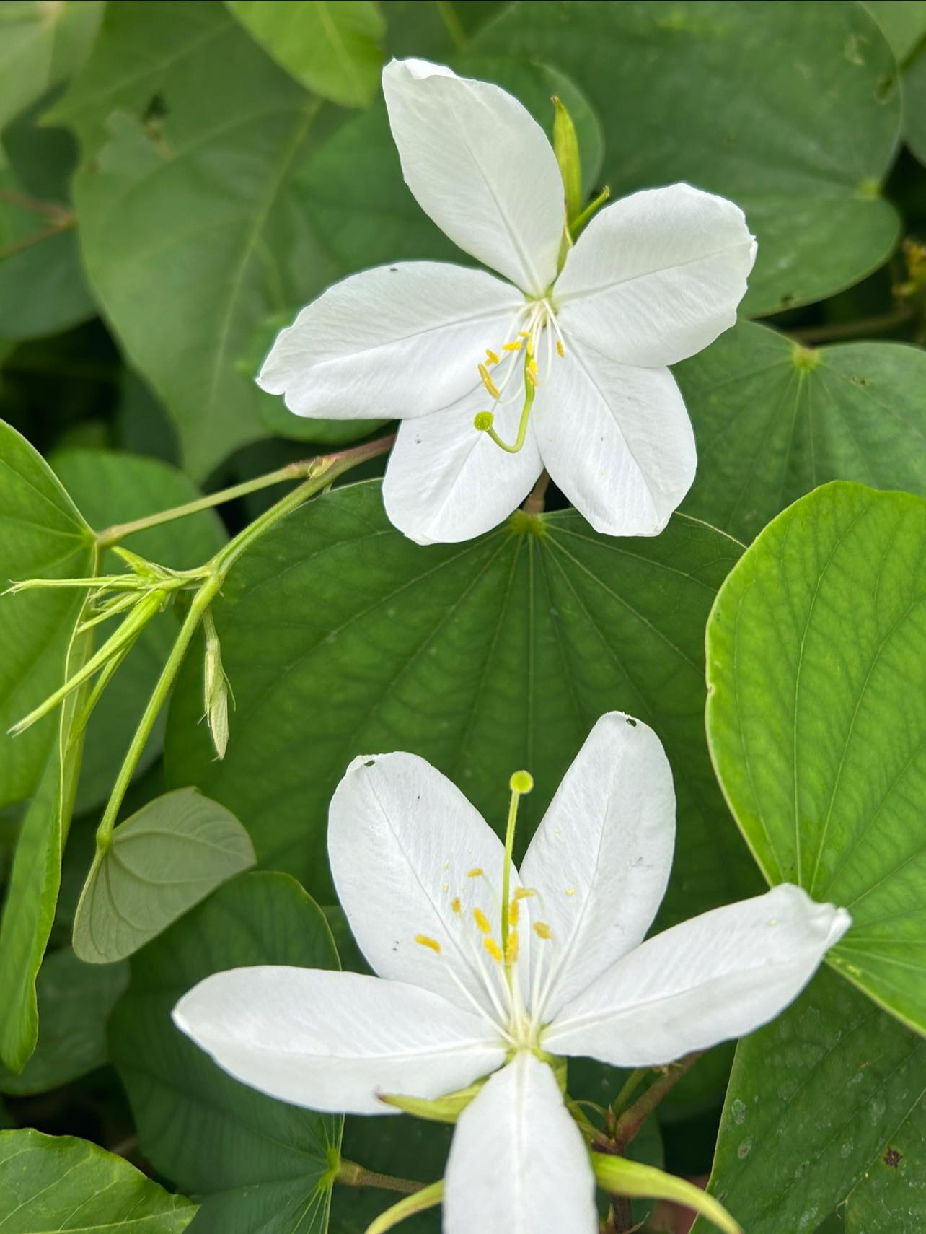
HACK KRMU 5.0
UNIQUENESS & INNOVATION FACTOR
Integrates traditional Ayurvedic knowledge with AI
Personalized diet based on individual constitution (not generic plans)
Image-based food logging for seamless tracking
Real-time Dosha imbalance alerts
Preventive healthcare approach instead of reactive treatment
  Scalable wellness-tech model
05

Slide 6
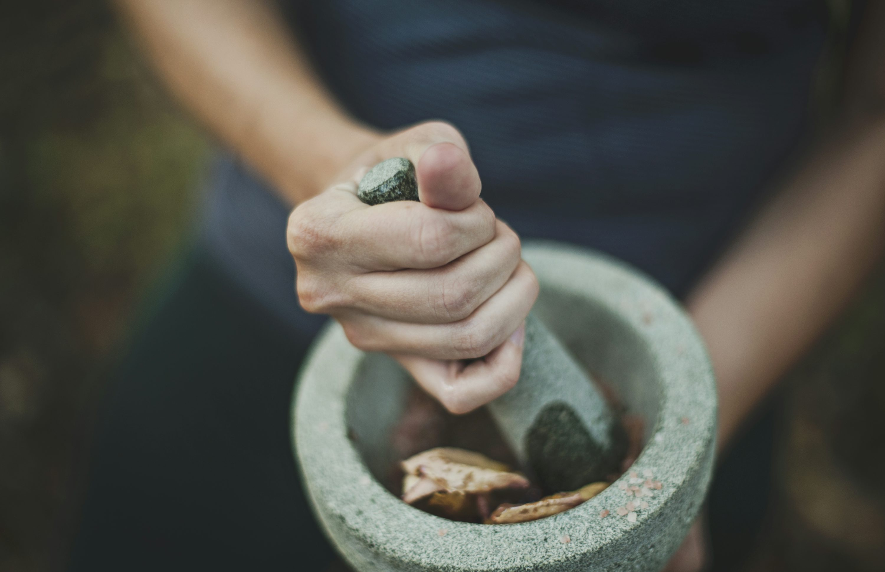
HACK KRMU 5.0
FEASIBILITY:
Rule-based DOSHA ENGINE ENSURES QUICK IMPLEMENTATION
PRETRAINED ML MODELS REDUCE TRAINING COMPLEXITY
MODULAR BACKEND ENABLES SCALABILITY
SUITABLE FOR MVP WITHIN HACKATHON TIMELINE
CHALLENGES:
Accuracy of food recognition
Simplifying complex Ayurvedic concepts
Ensuring responsible health guidance
Managing user health data securely
How We Address Them:
Using validated datasets
Secure authentication system
Continuous model improvement strategy
06

Slide 7


HACK KRMU 5.0
Research & Reference
AYURVEDIC PRINCIPLES DERIVED FROM CLASSICAL TEXTS SUCH AS CHARAKA SAMHITA
MODERN NUTRITIONAL DATASETS FOR CALORIE & NUTRIENT MAPPING
PRETRAINED CNN MODELS FOR FOOD RECOGNITION
WHO REPORTS ON PREVENTIVE HEALTHCARE AND LIFESTYLE DISORDERS
RESEARCH ON PERSONALIZED NUTRITION SYSTEMS
07

Slide 8
HACK KRMU 5.0
Thank You!!

